Slide 1

Attendance-System through Real-time Database

Slide 2
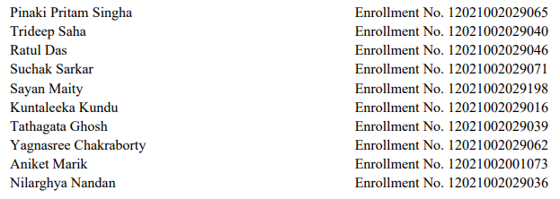
Project report in partial fulfilment of the requirement for the award of the degree of Bachelor of Technology In CSE (IOT, BCT, CYS)
Submitted by-
Under the guidance of
Prof. Sandip Mondal
Department of CSE (IOT, BCT, CYS)

Slide 3
Acknowledgement
We would like to take this opportunity to thank everyone whose cooperation and encouragement throughout the ongoing course of this project remains invaluable to us. We are sincerely grateful to our guide Prof. Sandip Mondal of the Department of CSE (IOT, BCT, CYS), UEM, Kolkata, for his wisdom, guidance and inspiration that helped us to go through with this project and take it to where it stands now. Last but not the least, we would like to extend our warm regards to our families and peers who have kept supporting us and always had faith in our work.

Slide 4
TABLE OF CONTENTS
01
ABSTRACT
05
PROPOSED SOLUTION
02
INTRODUCTION
06
EXPERIMENTAL SETUP AND RESULT ANALYSIS
03
LITERATURE SURVEY
04
PROBLEM STATEMENT
07
CONCLUSION & FUTURE SCOPE

Slide 5
01.
ABSTRACT
A NoSQL document-based database system is a type of database management system that stores and retrieves data in a document-oriented way. Instead of storing data in tables and rows like a traditional relational database, a NoSQL database stores data as documents, typically in JSON or BSON format. This allows for more flexibility in storing and querying data, as well as the ability to handle unstructured and semi-structured data.
One of the main advantages of a NoSQL document-based database system is its ability to scale horizontally, meaning it can handle increasing amounts of data by adding more nodes to the cluster. Additionally, since documents can be self-contained and hierarchical, they can be retrieved in a single query, reducing the need for complex join operations.
NoSQL databases also allow for easier schema evolution and can handle data with varying structures and types.
Our main objective is to use this technology to build a working attendance system that would first take visual image face data followed by maintaining a database system

Slide 6
2. INTRODUCTION
NoSQL is a type of database management system that is used to store and manage data in a non-tabular form, unlike traditional relational database management systems (RDBMS). In NoSQL databases, the data is stored in a non-tabular format, such as key-value pairs, document-oriented, graph-based or other formats. One of the most popular types of NoSQL databases is document-based databases, which are used to store and manage data in the form of documents. MongoDB is a widely used document-based NoSQL database system.
MongoDB is a widely used document-based NoSQL database system. It is an open-source database that is designed to store and manage large volumes of unstructured and semi-structured data. MongoDB is written in C++ and provides a flexible document model that allows users to store data in JSON-like documents with dynamic schemas. This means that data can be stored without a predefined structure, which makes MongoDB highly scalable and adaptable to different types of data
Another advantage of MongoDB is its scalability. MongoDB is designed to scale horizontally, meaning that new servers can be added to the cluster to handle additional data and requests. This makes it easier for organizations to handle large volumes of data and ensures that the database can handle the load as the organization grows.

Slide 7
3. LITERATURE SURVEY
NoSQL databases have become increasingly popular in recent years due to their ability to store and manage large volumes of unstructured data.
A NoSQL database is designed to handle unstructured data, such as text, images, videos, and other multimedia files, which makes them an ideal choice for many modern applications.
One of the most popular NoSQL databases is MongoDB, a document-based database that allows users to store data in flexible, JSON-like documents
One of the key advantages of MongoDB is its support for complex queries and indexing. Unlike traditional relational databases, MongoDB does not use a schema to define the structure of the data.
In addition to its support for NoSQL databases, MongoDB also has several other features that make it an attractive choice for many developers.
For example, it supports atomic transactions, which ensure that data is always consistent and reliable. It also has built-in support for data encryption, which helps toensure that data is always secure and protected.

Slide 8
4. PROBLEM STATEMENT
Manual attendance tracking has been a prevalent practice for decades, and it remains a critical aspect of various organizational settings. However, it is prone to several limitations, such as errors in recording, time-consuming processes, and possible tampering. As organizations continue to grow and the demand for efficiency and accuracy increases, there is a need for a more streamlined and secure attendance tracking system. Automating the attendance system can address these limitations and help organizations save time, effort, and resources while increasing accuracy and security.
The proposed system leverages face detection to provide a more reliable and better attendance tracking process. The system can detect and recognize individuals' faces and capture their attendance with a considerable level of accuracy. This dual-technology approach enhances the system's security, as it reduces the likelihood of fraud or impersonation.

Slide 9

5. PROPOSED SOLUTION
Use a camera for face detection and recognition to automate attendance tracking.
Integrate prompt window input for more secure recording process.
Use a NoSQL document-based database system such as MongoDB to store attendance records securely and efficiently.
Ensure data privacy and security by implementing appropriate access controls and encryption measures.

Slide 10
6. EXPRERIMENTAL SETUP AND RESULT ANALYSIS
Requirements/Setup:
PyMongo: Python library used for working with MongoDB, a popular NoSQL document-based database system. It allows Python developers to interact with MongoDB databases, collections, and documents
speech_recognition: Python library that allows developers to easily integrate speech recognition capabilities into their applications.
cv2: cv2 is a popular computer vision library in Python used for various image and video processing applications.
Pyttsx3: Pyttsx3 is a Python package that provides a simple and easy way to convert text to speech.
PyAudio: Python library that provides a simple and easy-to-use interface for working with audio data in real-time.
EasyGUI: Python library for creating simple GUI (Graphical User Interface) applications.
Camera (USB): A working desktop/laptop compatible or integrated camera. The better the resolution, the better the accuracy of the model.
Python: Any device capable of execution and using python libraries is sufficient.

Slide 11
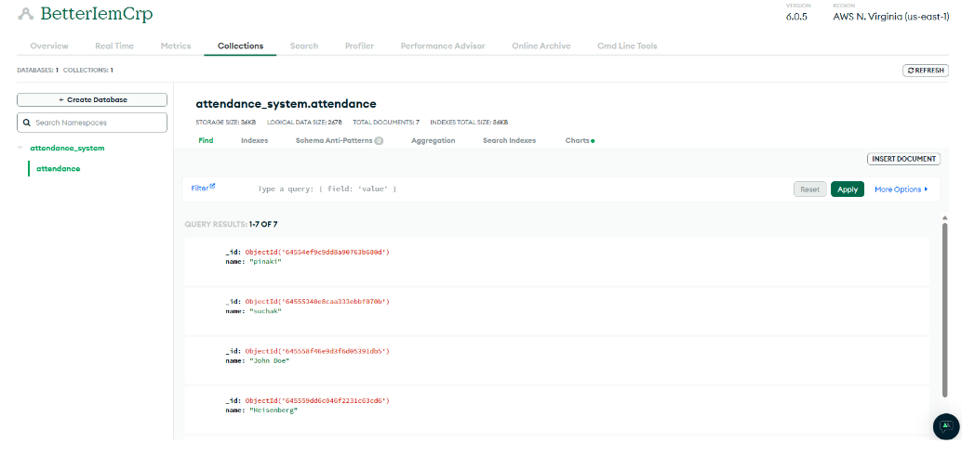
DATABASE CONFIGURATION

Slide 12
7. CONCLUSION
The above Python code is a basic attendance system that uses face detection to take attendance and store it in a MongoDB database.
The system can detect and recognize faces, capture the name of the person and add their name to the attendance database. The system also uses text-to- speech to provide feedback to the user about the success of their attendance.
In terms of future scope, this system can be further enhanced to include more features such as automatic email notifications to teachers or parents about the attendance of their students, integration with other biometric technologies like fingerprint or iris recognition, and the ability to generate reports on attendance for specific time periods or individual students.
Additionally, the system can be made more secure by implementing authentication mechanisms for access to the attendance database

